Slide 1
Chapter 4: Understanding Quality Attributes

Slide 2
Architecture and Requirements
System requirements can be categorized as:
  Functional requirements state what the system must do, how it must behave or react to run-time stimuli.
  Quality attribute requirements qualify functional requirements, e.g., how fast the function must be performed, how resilient it must be to erroneous input, etc.
  Constraints. A constraint is a design decision with zero degrees of freedom.

Slide 3
Functionality
Functionality is the ability of the system to do the work for which it was intended.
Functionality has a strange relationship to architecture:
  functionality does not determine architecture;

Slide 4
Quality Attribute Considerations
If a functional requirement is "when the user presses the green button the Options dialog appears”:
  a performance qualification might describe how quickly the dialog will appear;
  an availability qualification might describe how often this function will fail, and how quickly it will be repaired;
  a usability qualification might describe how easy it is to learn this function.

Slide 5
Two Categories of Quality Attributes
The ones that describe some properties of the system at runtime
  Availability, performance, usability, security
The ones that describe some properties of the development of system
  Modifiability
  Testability

Slide 6
Quality Attribute Considerations
There are problems with previous discussions of quality attributes:
Untestable definitions. The definitions provided for an attribute are not testable. It is meaningless to say that a system will be “modifiable”
Overlapping concerns. Is a system failure due to a denial of service attack an aspect of availability, performance, security, or usability?

Slide 7
Quality Attribute Considerations
A solution to the problems (untestable definitions and overlapping concerns) is to use quality attribute scenarios as a means of characterizing quality attributes.

Slide 8
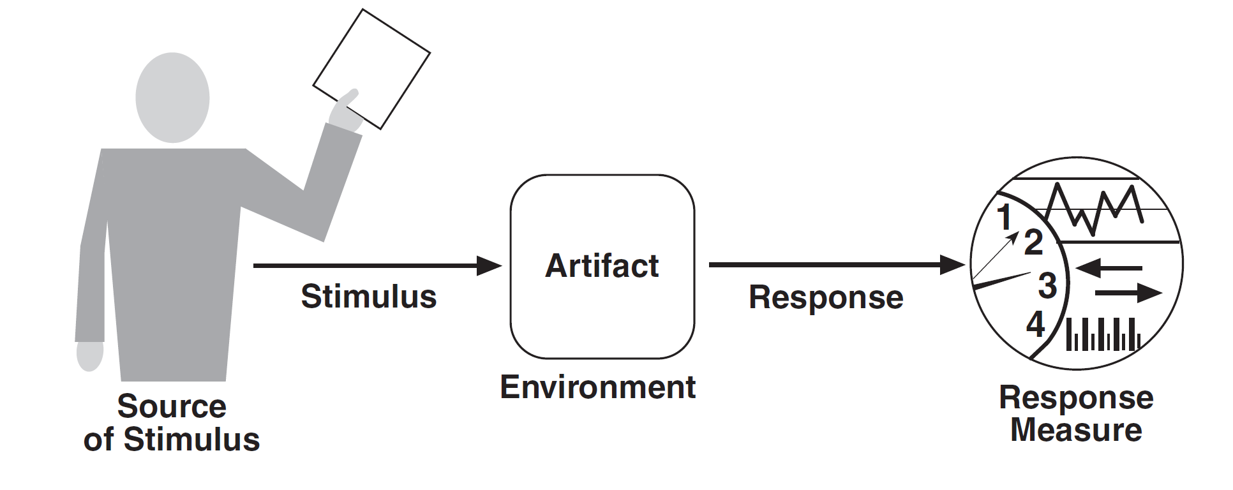
Specifying Quality Attribute Requirements
We use a common form to specify all quality attribute requirements as scenarios.
Our representation of quality attribute scenarios has these parts:

Slide 9
Specifying Quality Attribute Requirements
Stimulus 刺激. The stimulus is a condition that requires a response when it arrives at a system. A stimulus for modifiability is a request for a modification; a stimulus for testability is the completion of a phase of development.
Source of stimulus 来源. This is some entity (a human, a computer system, or any other actuator) that generated the stimulus.
Response 响应. The response is the activity undertaken as the result of the arrival of the stimulus.
Response measure响应度. When the response occurs, it should be measurable in some fashion so that the requirement can be tested.
Environment 环境. The stimulus occurs under certain conditions. The system may be in an overload condition or in normal operation, or some other relevant state.
Artifact制品. This may be a collection of systems, the whole system, or some piece or pieces of it. Some artifact is stimulated.

Slide 10
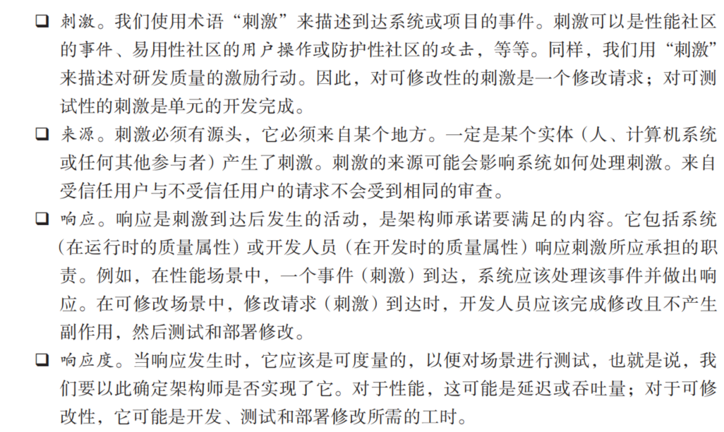
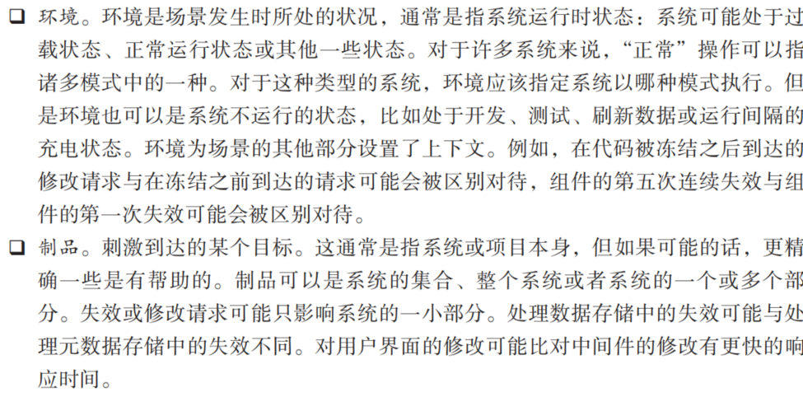

Slide 11
Specifying Quality Attribute Requirements
General quality attribute scenarios are system independent and can, potentially, pertain to any system
Concrete quality attribute scenarios are specific to the particular system under consideration.

Slide 12
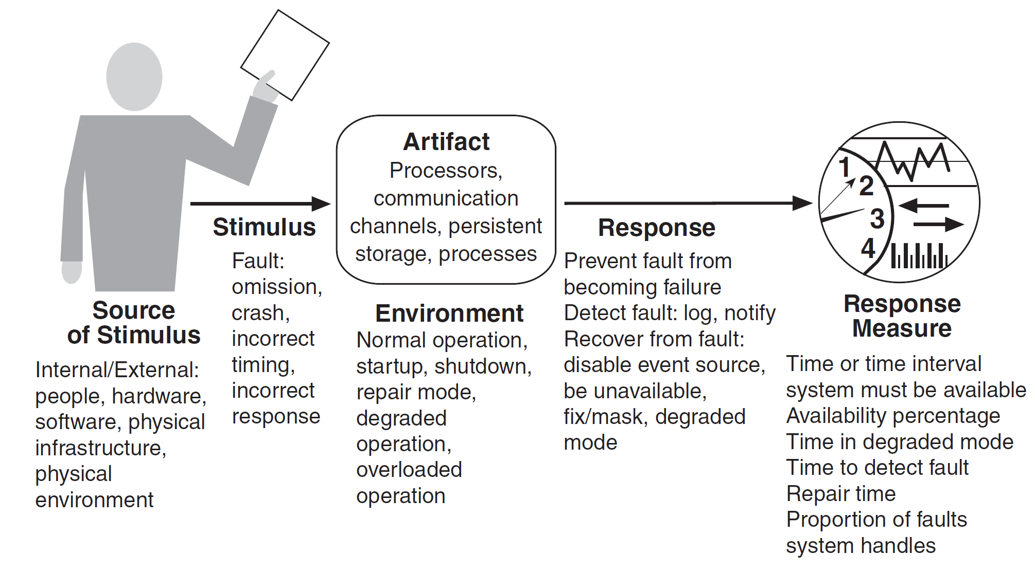
Specifying Quality Attribute Requirements
Example general scenario for availability:

Slide 13
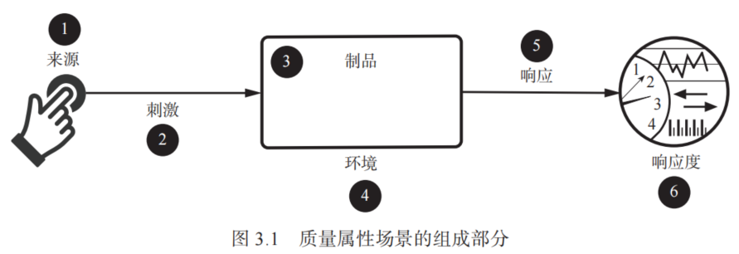
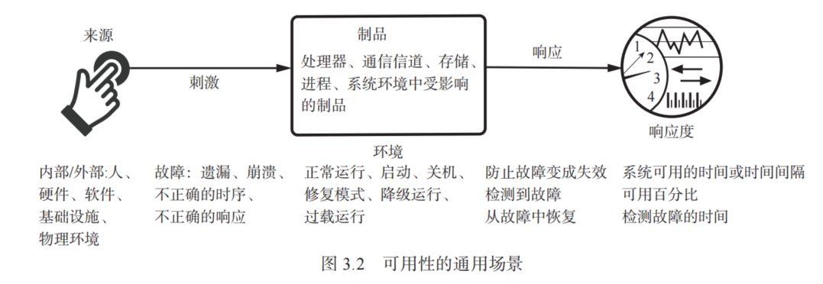

Slide 14
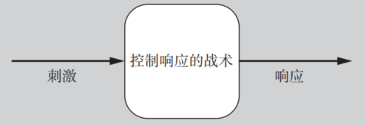
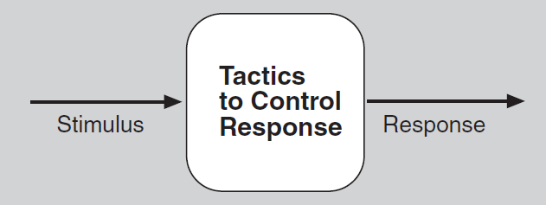
Achieving Quality Attributes Through Tactics
There are a collection of primitive design techniques that an architect can use to achieve a quality attribute response.
We call these architectural design primitives tactics.
Tactics, like design patterns, are techniques that architects have been using for years.
We do not invent tactics, we simply capture what architects do in practice.

Slide 15
Tactic v.s. Architectural pattern
A tactic is a design decision for a single quality attribute (e.g.,Fault Detection is for Availability)
A tactic does not consider tradeoffs among quality attributes
Architectural patterns can be seen as “packages” of tactics, in which tradeoffs are considered

Slide 16
Tactic v.s. Architectural pattern
思政/军事概念 | 软件/创业对应
农村包围城市（战略/模式） | 边缘市场切入、下沉市场、非主流技术栈
游击战（战术） | 小步快跑、快速试错、避开正面竞争
集中优势兵力（战术） | 单点突破、极窄场景做到极致
根据地建设（战术） | 先跑通一个可复制的单元模型

Slide 17
Achieving Quality Attributes Through Tactics
We need to isolate, catalog, and describe the tactics. Why do we do this?
  Design patterns are complex, and often difficult to apply as is; architects need to modify and adapt them.
  If no pattern exists to realize the architect’s design goal, tactics allow the architect to construct a design fragment from “first principles”.
  By cataloguing tactics, we will have a choice of multiple tactics to improve a particular quality attribute. The choice of which tactics to use depends on factors such as the cost to implement.
Notes:
1）模式是许多架构的基础，但有时可能没有模式可以完全解决你的问题。例如，你
可能需要高可用性、高安全性的代理模式，而不是教科书中的代理模式。架构师经常需要
修改和调整模式以适应其特定的环境，战术提供了一种系统的方法来扩充现有模式以填补
空白。
2）如果不存在实现架构师设计目标的模式，战术允许架构师根据“首要原则”来构建设计片段，并让架构师能够洞察最终设计片段的属性。
3）战术提供了在一定限度内使设计和分析更加系统化的方法。我们将在下一节探讨这个问题。

Slide 18
Guiding Quality Design Decisions
Architecture design is a systematic approach to making design decisions.
We categorize the design decisions as follows:
  Allocation of responsibilities
  Coordination model
  Data model
  Management of resources
  Mapping among architectural elements:
  Binding time decisions
  Choice of technology

Slide 19
Allocation of Responsibilities
Decisions involving this include:
  identifying the responsibilities including basic system functions, architectural infrastructure, and satisfaction of quality attributes.
  determining how these responsibilities are allocated to non-runtime and runtime elements (namely, modules, components, and connectors).
For example, in an e-commerce system, we may clearly separate the responsibilities of user management, order processing, and payment systems, so that in subsequent system updates and maintenance, we can focus on a certain module without affecting other parts. (Modifiability)
Notes:
例如，在一个电子商务系统中，我们可能会将用户管理、订单处理和支付系统的职责明确分开，这样在后续系统的更新和维护中就可以专注于某一模块而不影响其他部分。

Slide 20
Coordination Model
Decisions about the coordination model include:
  identify the elements of the system that must coordinate, or are prohibited from coordinating
  determining the properties of the coordination, such as timeliness, currency, correctness, and consistency
  choosing the communication mechanisms that realize those properties.
    stateful vs. stateless, synchronous vs. asynchronous, guaranteed vs. non-guaranteed delivery
For example, in a banking system, the payment confirmation process may require synchronous coordination to ensure data consistency, while some background report generation can use asynchronous processing to improve system efficiency. (Security and Performance)
Notes:
Distributed matrix multiplication: timeliness, correctness
Transaction management: currency, consistency
Cooperative caching: consistency

Slide 21
Data Model
Decisions about the data model include:
  choosing the major data abstractions, their operations, and their properties.
  metadata needed for consistent interpretation of the data
  organization of the data, i.e., to decide whether the data is going to be kept in a relational data base, a collection of objects or both
For example, classes in object-oriented programming (Many)
Notes:
Relational data model,
key-value
Matrix model, graph model

Slide 22
Management of Resources
Decisions for this include:
  identifying the resources that must be managed and determining the limits for each
  determining which system element(s) manage each resource
  determining how resources are shared and the strategies employed when there is contention
  determining the impact of saturation on different resources.
For example, in a shared printer system, a print queue manager allocates printing tasks to avoid conflicts, ensuring fair access through strategies like FIFO or priority scheduling. Effective resource management maintains system stability under high load. (performance and availability)
Notes:
Take OS as an example:
CPU, memory, disk storage, I/O ports
Process management, memory management, file system, drivers for I/O ports
Scheduling, buffer replacement protocol
CPU overloaded, out of memory

Slide 23
Mapping Among Architectural Elements
Useful mappings include:
  the mapping of modules and runtime elements to each other
  the assignment of runtime elements to processors
  the assignment of items in the data model to data stores
  the mapping of modules and runtime elements to units of delivery
For example, assuming the system runs on a multi-core processor, the architect needs to assign these processes to different CPU cores (Performance)

Slide 24
Binding Time
The decisions in the other categories have an associated binding time decision. Examples of such binding time decisions include:
  Build-time v.s. run-time
  For choice of coordination model you can design run-time negotiation of protocols.
  For resource management you can design a system to accept new peripheral devices plugged in at run-time.
For example, theme switching function for mobile apps: Design-time binding, Build-time binding, Run-time binding (Usability)

Slide 25
Choice of Technology
Choice of technology decisions involve:
  deciding which technologies are available to realize the decisions made in the other categories
  determining whether the tools to support this technology (IDEs, simulators, testing tools, etc.) are adequate
  determining the extent of internal familiarity and external support for the technology (such as courses, tutorials, examples, availability of contractors)
  determining the side effects of choosing a technology such as a required coordination model or constrained resource management opportunities
  determining whether a new technology is compatible with the existing technology stack
Example: which programming language? (Many)

Slide 26
Summary
Requirements for a system come in three categories.
  Functional. These requirements are satisfied by including an appropriate set of responsibilities within the design.
  Quality attribute. These requirements are satisfied by the structures and behaviors of the architecture.
  Constraints. A constraint is a design decision that’s already been made.

Slide 27
Summary
To express a quality attribute requirement we use a quality attribute scenario. The parts of the scenario are:
  Source of stimulus.
  Stimulus
  Environment.
  Artifact.
  Response.
  Response measure.

Slide 28
Summary
An architectural tactic is a design decision that affects a quality attribute response. The focus of a tactic is on a single quality attribute response.
Architectural patterns can be seen as “packages” of tactics.
The seven categories of architectural design decisions are:
  Allocation of responsibilities
  Coordination model
  Data model
  Management of resources
  Mapping among architectural elements
  Binding time decisions
  Choice of technology

Slide 29
Class Review
1. Which one of the following statement is NOT true about software structures?
A. Software systems are composed of many structures, and no single structure holds claim to being the architecture
B. The module structure shows how each of the software elements behaves at run time
C. The component & connector structure shows how the software elements are interacted at run time
D. The deployment structure shows information about at which physical hardware the software elements are executed
Notes:
B

Slide 30
2. Which one of the following structure pertains to a component & connector structure?
A. Decomposition structure
B. Class structure
C. Layer structure
D. Concurrency structure
Notes:
C

Slide 31
3. Which of the following should be included in the consideration of a Module Structure?
A. What are the major executing components and how do they interact at runtime
B. what part of the system can run in parallel
C. What is the primary functional responsibility assigned to each software elements
D. How does data process through the system
Notes:
C

Slide 32
4. Which one of the following structures pertains to the Allocation Structure?
A. Service structure
B. Concurrency structure
C. Layer structure
D. Deployment structure
Notes:
C

